Slide 1
Northeastern Ontario’s Energy Future: Empowered Communities
FONOM 2025 Tuesday, May 6, 2025
Beverly Nollert, Director, Transmission Integration
Brian Gordon, Senior Manager, Regional and Community Engagement

Slide 2
Ontario’s Electricity Sector
Generators
Transmitters
Local Distribution Companies
Energy Consumers
COMMUNITIES

Slide 3
Demand is Going Up: The 25-Year Outlook
Net Annual Energy Demand (Terawatt-hours)

Slide 4
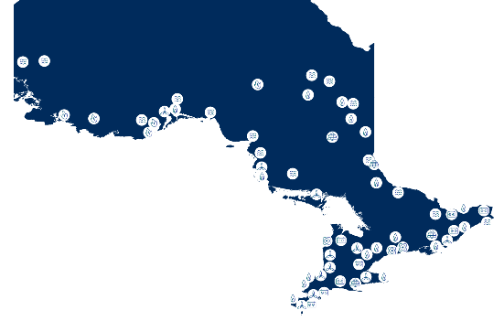
All of the Above Approach
Ontario’s Supply Mix
Nuclear
Hydro
Natural Gas
Wind
Solar
Battery Storage
Biofuel

Slide 5
Electricity Planning
Bulk
Planning
Regional
Planning
Distribution
Planning
Provincial electricity system needs and policy directions.
Local electricity system needs at the transmission system level.
Local electricity system needs and priorities at the distribution system level.
Complete: Northeast Bulk System Reinforcement and Northern Ontario Bulk Plan
Upcoming: North of Sudbury Bulk Study
Active: East Lake Superior
Upcoming: Sudbury/Algoma
Led by local distribution companies.

Slide 6
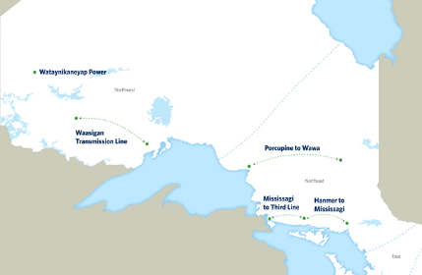
Bulk Transmission Planning
Project | In-service Date
Wataynikaneyap Power | 2024
Waasigan Line | 2025-2027
Mississagi to Third Line | 2029
Hanmer to Mississagi | 2029
Porcupine to Wawa | 2030
Bulk System Reactive Requirements in Northern Ontario | 2027-2029
Plans | Timeline
Northeast Bulk Plan | Completed 2022
Northern Ontario Bulk Plan | Jan 24-June 25
North of Sudbury Bulk Plan | 2025
Northern Ontario Connection Study | Ongoing

Slide 7
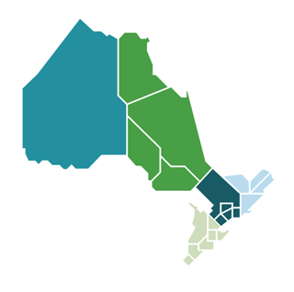
Regional and Bulk Planning
North of Sudbury Bulk Plan Upcoming
IESO Activities for the Northeast:
Assessing: East Lake Superior’s electricity needs and evaluating options to meet them
Launching: Sudbury/Algoma Integrated Regional Resource Plan
Completing: Northern Ontario Bulk Plan
Initiating: North of Sudbury Bulk Plan
Northern Ontario Bulk Plan
Active
East Lake Superior Integrated Regional Resource Plan
Active
Sudbury/Algoma Integrated Regional Resource Plan Upcoming

Slide 8
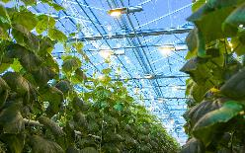
Energy Efficiency

Slide 9
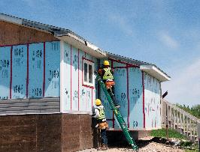
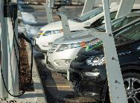
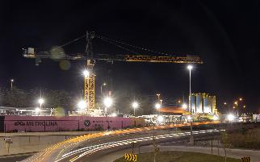
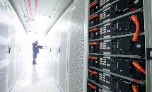
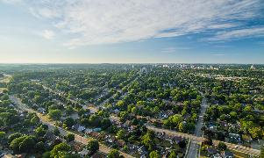
Electricity Is An Enabler

Slide 10
Get Involved
Communities are empowered to shape and support Ontario's electricity future
ieso.ca/learn | ieso.ca/subscribe Engagement sessions communityengagement@ieso.ca

Slide 11
Let’s Hear From You
ieso.ca
@IESO_Tweets
LinkedIn.com/company/IESO
saveonenergy.ca
@saveONenergyOnt
LinkedIn.com/showcase/saveonenergy-ontario/

