Slide 1
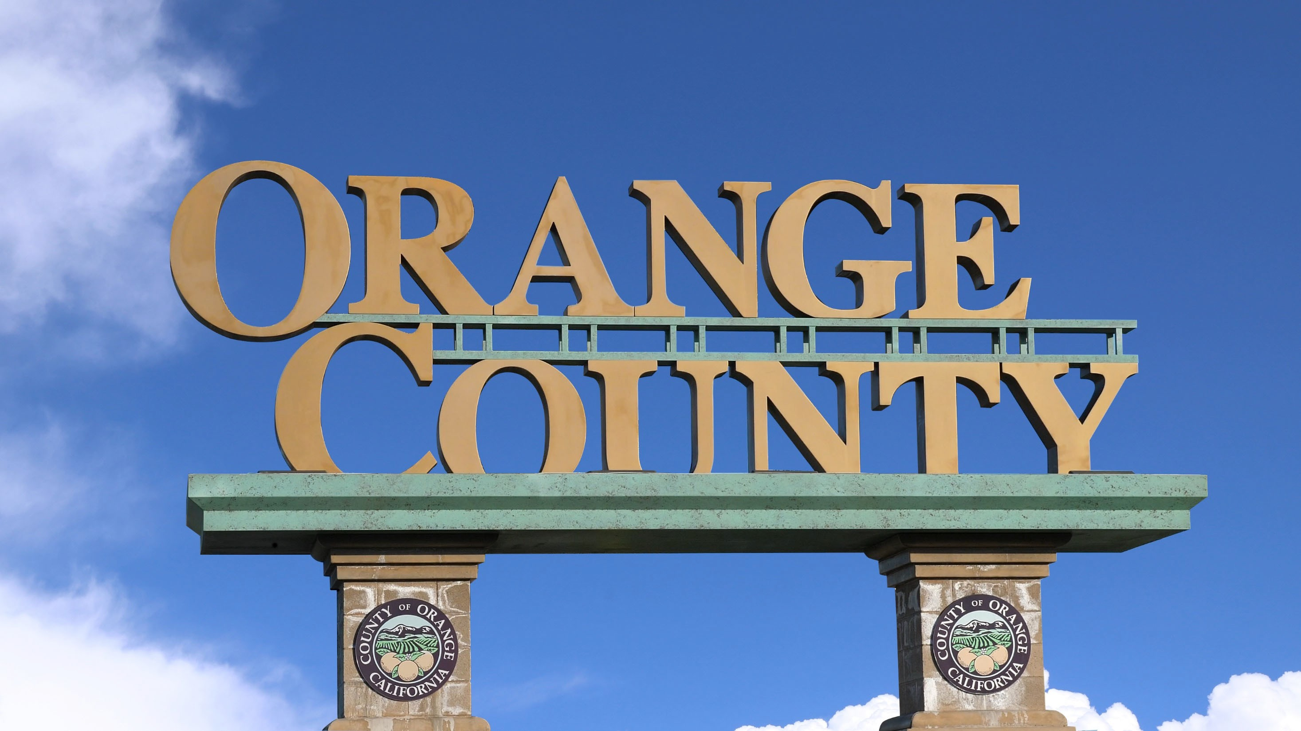
The Orange County Insolvency
Lessons for Northern Ontario
2025 Northeastern Municipal Conference
—
May 6th, 2025

Slide 2
The Orange County Insolvency | Lessons for Northern Ontario
01 Acknowledgement
This presentation is built in large part on an excellent analysis of the Orange County bankruptcy by the Public Policy Institute of California (PPIC), which in turn summarizes a joint publication between the PPIC and Mark Baldassare: When Government Fails: The Orange County Bankruptcy.
While Orange County is 4,373 kilometres from North Bay by road and in a different country with a different government framework, the analysis provided by the PPIC (in the view of the presenter) is as meaningful to Northern Ontario municipalities as other local governments.

Slide 3
02 Why This Matters
The Orange County Insolvency | Lessons for Northern Ontario
What happened in Orange County is, in a deep sense, a failure of governance – not just of government. The responsibility lies with not only the elected and appointed officials but also with the voters. They showed little interest in who was being elected and a great distrust of government – given the large numbers who did not vote in the local elections and the overwhelming support for tax limits among those who went to the polls. They put their elected officials in an impossible position by constraining their ability to raise revenues and continuing to demand the same or better services.
When Government Fails: The Orange County Bankruptcy
A Policy Summary Public Policy Institute of California
Page 20

Slide 4
03 The Orange County Insolvency
The Orange County Insolvency | Lessons for Northern Ontario
$800M
$1.2B
$800M
$1.2B
$800M
$1.2B
$400M
$1.6B
$400M
$1.6B
$400M
$1.6B
$2.0B
$2.0B
$2.0B
$217 million
Value of debt involved in 362 municipal insolvencies between 1937 and 1994
$1.6 billion
Value of debt involved in the Orange County insolvency
$1.0 billion
Value of debt involved in Orange County’s near-miss default in 1995

Slide 5
03 The Orange County Insolvency
The Orange County Insolvency | Lessons for Northern Ontario
1994
The Pool has a total value of $20.6 billion,
including $7.6 billion of funds from the County and almost 200 public agencies and $13.0 in leveraged investments
California voters pass Proposition 13 which sets property taxes at 1% and limits future increases to no more than 2% per year
In November 1994, the County’s auditors disclose that the Pool had lost
$1.64 billion
1978
1991-1992
Orange County treasurer Robert Citron
begins a high risk, high leverage investment strategy to realize increased income from the Orange County Investment Pool
The County approves a FY1995 budget that calls for 35% of general fund revenues to come from investments, up from 12% in FY1994 and compared to 3% for other California counties
As lenders threatened to seize assets as collateral for loans, the County files for Chapter 9 bankruptcy protection

Slide 6
03 Investment Income for FONOM Municipalities (2023)
The Orange County Insolvency | Lessons for Northern Ontario
109
Investment income as a percentage of total municipal revenue
10%
8%
6%
4%
2%
0%
FONOM
municipalities
2.1%
Investment income as a percentage of total revenue
During 2023, FONOM municipalities reported a total of $1.94 billion in municipal revenues, with investment income amounting to $39.1 million of this amount
49.7%
Taxation revenue as a percentage of total revenue
Investment income as a percentage of total municipal revenue
13% 37% 46%
4%
None
Less than 2%
2% to 5%
More than 5%

Slide 7
03 The Orange County Insolvency
The Orange County Insolvency | Lessons for Northern Ontario
Orange County existed bankruptcy protection on June 12th, 1996
Sales Tax Increase
A half-cent sales tax increase was proposed in March 1995 but ultimately was rejected by voters
$1B
One year extension by existing bondholders
Investment Settlement
Pool investors would get most of their money back immediately with the rest to follow, conditional upon no lawsuits against the County and pending lawsuits against investment firms
Diversion of funds
Monies were redirected from other uses into order to pay creditors
$880M
Bond issuance to refinance liabilities

Slide 8
03 The Orange County Insolvency
The Orange County Insolvency | Lessons for Northern Ontario
The symptom
High risk, high leverage investment strategy that resulted in significant market losses
Root causes
Political fragmentation
Voter distrust
State fiscal austerity
Bob Citron was not the cause of the bankruptcy; he was the catalyst that made those three necessary conditions sufficient
© 2025 KPMG LLP, an Ontario limited liability partnership and a member firm of the KPMG global organization of independent member firms affiliated with KPMG Intern English company limited by guarantee. All rights reserved. The KPMG name and logo are trademarks used under license by the independent member firms of the KPMG
^{ational Limited, a private} Document Classification: KPMG Public global organization.
8

Slide 9
04 Political Fragmentation
The Orange County Insolvency | Lessons for Northern Ontario
An area is politically fragmented if each pursues its own goals and separate policies without regional coordination and often in competition with others. This fragmentation gives rise to problems such as traffic congestion, air pollution, sprawling land-use patterns, lack of affordable housing, inefficient delivery of public services – and in the case of Orange County, lack of oversight for a county treasurer who would push the county into financial crisis.
When Government Fails: The Orange County Bankruptcy
A Policy Summary Public Policy Institute of California
Page 8
© 2025 KPMG LLP, an Ontario limited liability partnership and a member firm of the KPMG global organization of independent member firms affiliated with KPMG International Limited, a private English company limited by guarantee. All rights reserved. The KPMG name and logo are trademarks used under license by the independent member firms of the KPMG global organization.

Slide 10
04 Voter Distrust
The Orange County Insolvency | Lessons for Northern Ontario
This citizen’s revolt against taxes should not be confused with a desire to have local government cut spending on the services that these voters value. The logic of this position is questionable and it has led some commentators to say that anti-tax voters simply want something for nothing. However, many believe that most public bureaucracies, including their own local governments, are inefficient, if not dishonest, and squander tax monies.
This distrust and low regard for officials’ handling of money explains why these voters can justify their demand for lower taxes while asking local leaders to maintain current spending levels and provide high-quality services. No matter how draconian the cuts, anti-tax voters continue to believe that there is financial waste in government that can be transformed into sufficient funds for the services they want.
When Government Fails: The Orange County Bankruptcy
A Policy Summary Public Policy Institute of California
Page 9
© 2025 KPMG LLP, an Ontario limited liability partnership and a member firm of the KPMG global organization of independent member firms affiliated with KPMG International Limited, a private English company limited by guarantee. All rights reserved. The KPMG name and logo are trademarks used under license by the independent member firms of the KPMG global organization.

Slide 11
04 State Fiscal Austerity
The Orange County Insolvency | Lessons for Northern Ontario
Local governments have long relied on federal and state monies to fund programs and help build infrastructure. In California, state budget pressures have cut back the state’s ability to fund public infrastructure projects and local public services. This austerity at higher levels puts suburban governments, like Orange County, under tremendous pressures to find additional funds for services. Voter distrust has deepened fiscal austerity [by] cutting property tax revenues for local governments.
Under these circumstances, when the state hits a financial pothole, counties go into financial whiplash.
When Government Fails: The Orange County Bankruptcy
A Policy Summary Public Policy Institute of California
Page 10
© 2025 KPMG LLP, an Ontario limited liability partnership and a member firm of the KPMG global organization of independent member firms affiliated with KPMG International Limited, a private English company limited by guarantee. All rights reserved. The KPMG name and logo are trademarks used under license by the independent member firms of the KPMG global organization.

Slide 12
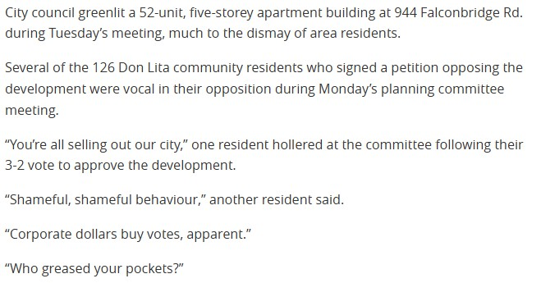
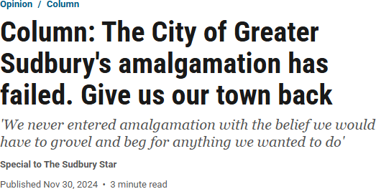
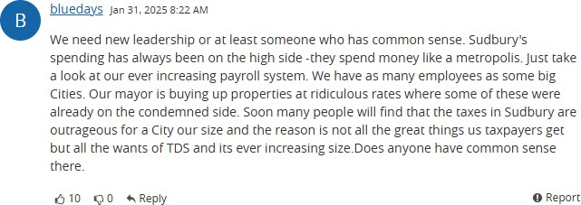
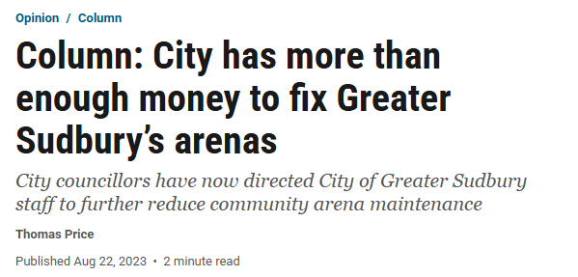
The Orange County Insolvency | Lessons for Northern Ontario
05 The Tone of the Distrusting Resident

Slide 13
05 The Tone of the Distrusting Resident
The Orange County Insolvency | Lessons for Northern Ontario
Indicators
Population Households
Lane kilometers of paved roads Number of scheduled passenger trips
Kilometers of mains (water, wastewater, urban stormwater)
Total area of indoor recreational space Long-term care beds
Residential taxes
Greater Sudbury 166,004
75,967
2,987
5,220,997
2,468
113,577
433
$237.7 million
Kawartha Lakes 79,247
41,085
3,711
51,780
630
44,731
166
$124.2 million

Slide 14
05 The Tone of the Distrusting Resident
The Orange County Insolvency | Lessons for Northern Ontario
Full-time staffing
Administration Full-time Fire
Police and Court Security Transit
Public Works
Parks and Recreation Long-term Care
Greater Sudbury 174
140
422
116
467
87
261
Kawartha Lakes 209
32
67
8
146
30
103

Slide 15
05 The Tone of the Distrusting Resident
The Orange County Insolvency | Lessons for Northern Ontario
Staff per Thousand Households
Administration
Full-time Fire
Full-time and Volunteer Firefighters Police and Court Security
Amount paid to OPP for policing services
Greater Sudbury 2.29
1.84
4.71
5.55
$Nil
Kawartha Lakes 5.09
0.78
8.73
1.63
$8.0 million

Slide 16
05 The Tone of the Distrusting Resident
The Orange County Insolvency | Lessons for Northern Ontario
Staff per Level of Service Indicator
Public Works Staff per 1,000 km of Linear Infrastructure
Amount paid to OCWA for operations
Recreation Staff per 10,000 m2 of Indoor Recreation Space Long-term Care Staff per Bed
Transit staff per 100,000 passenger rides Number of transit routes
Greater Sudbury 85.6
$Nil
7.7
0.6
2.2
25
Kawartha Lakes 33.6
$7.6 million
6.7
0.6
15.4
4

Slide 17
05 The Tone of the Distrusting Resident
The Orange County Insolvency | Lessons for Northern Ontario
Greater Sudbury
Kawartha Lakes
On average, Greater Sudbury charges $3,129 in residential taxes per household, compared to
$3,023 per household in Kawartha Lakes. This differential of $106 is arguably due, in large part, to differences in
services and service levels

Slide 18
06 Why This Matters
The Orange County Insolvency | Lessons for Northern Ontario
Annual Change in Operating Revenue (2019 to 2023)
27%
FONOM
municipalities reporting less operating revenue in 2023
than 2019
43%
FONOM
municipalities with annual growth in operating revenues less than inflation
35%
30%
25%
20%
15%
10%
5%
Average CPI
3.49%
0%
-5%
-10%
-15%
-20%

Slide 19
06 Why This Matters
The Orange County Insolvency | Lessons for Northern Ontario
Annual Change in Taxation Revenue (2019 to 2023)
4%
FONOM
municipalities reporting less taxation revenue in 2023 than
2019
38%
FONOM
municipalities with annual growth in taxation revenues less than inflation
9%
8%
7%
6%
5%
4%
Average CPI
3.49%
3%
2%
1%
0%
-1%

Slide 20
06 Why This Matters
The Orange County Insolvency | Lessons for Northern Ontario
$452M
2023 Reserves and
Reserve Funds
$302M
2023 Long-term
Debt
$150M
Net Financial
Position
Reserves and debt go hand in hand, with the view that lower reserve balances are acceptable if corresponding debt levels are low as well. Looking at the net financial position of a municipality – total reserves less total debt – reflects this concept.
Over the last five years, the net financial position of FONOM municipalities has increased by $77 million. However, this increase is not consistent across the region, with 35% of municipalities reporting a decrease in net financial position during this period.
35%
Number of FONOM
municipalities reporting
a decrease in net financial position

Slide 21
07 Lessons From Orange County
The Orange County Insolvency | Lessons for Northern Ontario
While the resulting breed of “New Financial Populists” in local government flourishes under the conditions of voter distrust, they also face a serious dilemma: They must devise fiscal strategies that allow them to maintain or decrease taxes and at the same time maintain or increase spending for local services. There is just so far they can go with measures to increase productivity, improve fiscal management of existing tax revenues, and selectively adopt low-visibility revenue-raising devices. When, as happened in 1994, the state cuts local revenues, local leaders must be especially creative. The difficulty of the dilemma explains why Orange County local leaders closed their eyes to the possible problems with a high-risk investment strategy that was giving them badly needed high-interest income.
When Government Fails: The Orange County Bankruptcy
A Policy Summary Public Policy Institute of California
Page 9
© 2025 KPMG LLP, an Ontario limited liability partnership and a member firm of the KPMG global organization of independent member firms affiliated with KPMG International Limited, a private English company limited by guarantee. All rights reserved. The KPMG name and logo are trademarks used under license by the independent member firms of the KPMG global organization.
Document Classification: KPMG Public
21

Slide 22
07 Lessons From Orange County
The Orange County Insolvency | Lessons for Northern Ontario
For what it’s worth…
A number of policy recommendations were made to address future challenges faced by municipalities, many of which would seem to be relevant to FONOM
municipalities
Local governments need to maintain high standards for fiscal oversight and accountability
Local officials need more financial expertise and objective professional advice so that they can make sound fiscal policy decisions in the complex world of municipal finance.
Equity issues should be considered in fiscal emergencies; because the poor rely heavily of municipal services, their voices need to be heard in decisions about budget cuts.
Local officials should be wary about citizens’ pressures to implement local fiscal policies that are popular in the short run but financially disastrous over time.

Slide 23
07 Lessons From Orange County
The Orange County Insolvency | Lessons for Northern Ontario
For what it’s worth…
Additional policy recommendations may also be relevant to FONOM’s position as an advocacy body for Northern municipalities
Provincial governments should encourage local governments to engage more actively in regional cooperation
Local governments need more flexibility in spending Provincial government funds they receive, especially during a local fiscal emergency
Requirements for public meetings by local legislators should be suspended during fiscal emergencies, allowing elected officials to meet as a group and candidly and imaginatively analyse and respond to the situation.

Slide 24
home.kpmg/ca
© 2025 KPMG LLP, an Ontario limited liability partnership and a member firm of the KPMG global organization of independent member firms affiliated with KPMG International Limited, a private English company limited by guarantee. All rights reserved. The KPMG name and logo are trademarks used under license by the independent member firms of the KPMG global organization.
Document Classification: KPMG Public

