Slide 1
Insights and Innovation:
MPAC’s work in Northern Ontario
Municipal Property Assessment Corporation
FONOM Conference North Bay, Ontario May 5 - 7, 2025

Slide 2
Our vision: To be a global leader
Our new strategic plan
Innovation and AI
The customer experience

Slide 3
Shaping tomorrow: Our new strategic plan
Powered by:
Our people
Innovation
A customer-first approach
Strengthening our bottom line

Slide 4
Innovation through AI: Driving the future
Collaborating with our partners
MPAC's AI policy
The AI Working Group

Slide 5
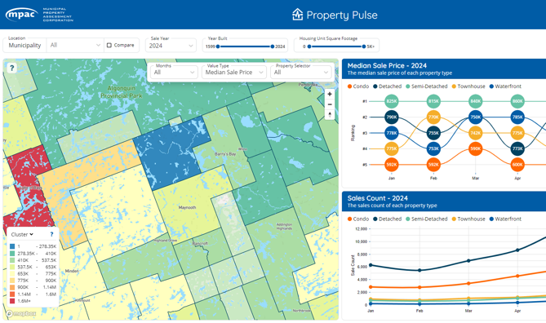
Enhancing
municipal data products and services
Delivering expert assessments
Innovating existing services
Partnering on new initiatives
Providing valuable data

Slide 6
Supporting municipalities and property owners through education

Slide 7
What to expect during an assessment update year
More frequent communication
Improved data access
Expanded education and outreach

Slide 8
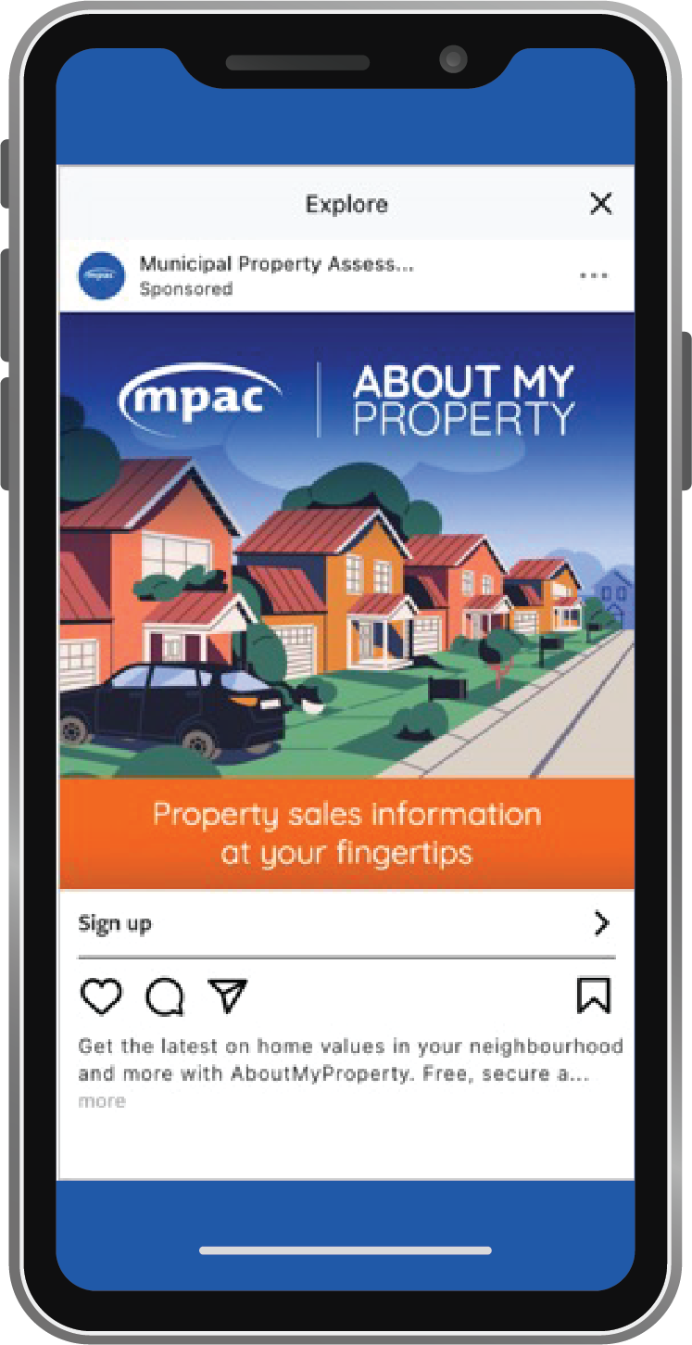
Elevating public understanding of assessment
Overview of tools like mpac.ca, First-time Homeowners’ Hub, videos
Results from the Home Values awareness campaign
Collaboration with municipalities to improve understanding

Slide 9
Delivering value through local insights

Slide 10
Top 10 new assessment in Northeastern Ontario
1
Greater Sudbury
$180,790,985
6
West Nipissing
$20,607,200
2
Sault Ste Marie
$62,172,124
7
Carling
$19,451,000
3
Seguin
$59,687,000
8
Timmins
$18,820,000
4
North Bay
$40,903,524
9
McKellar
$15,485,400
5
Temiskaming Shores
$24,122,100
10
The Archipelago
$14,490,000

Slide 11
Median sales price
by property type, year-over-year

Slide 12
Top 10 municipalities
largest change in median sale price

Slide 13
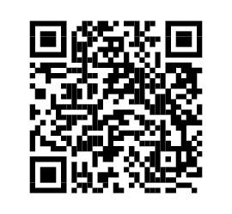
Top 5 municipalities
largest change in median sale price
Want more insights? Check out our Research and Insights page.

Slide 14
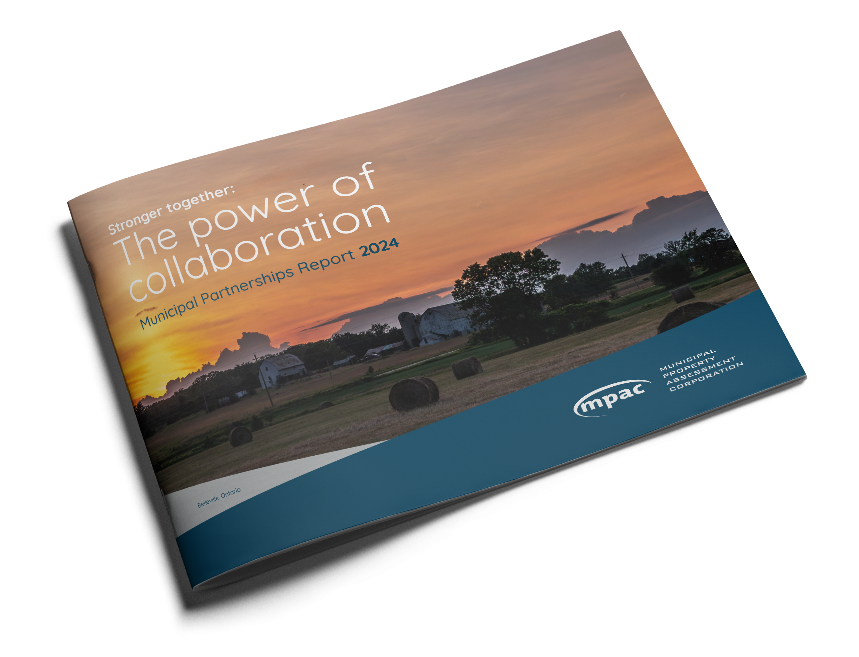
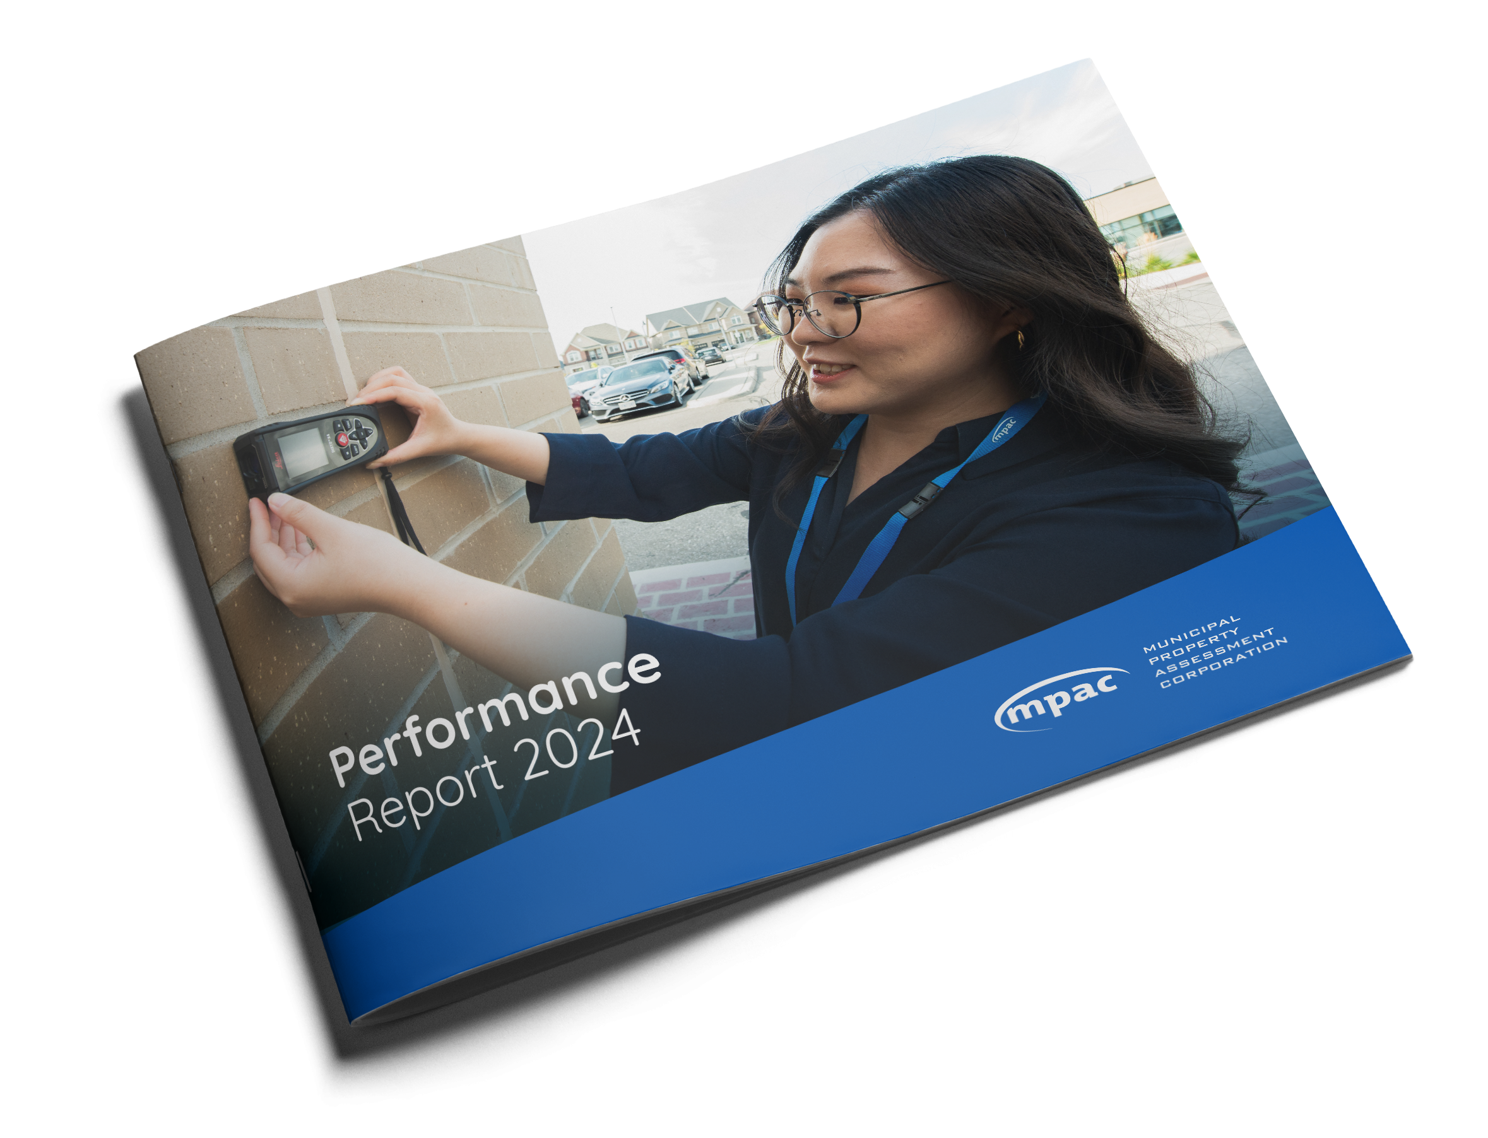
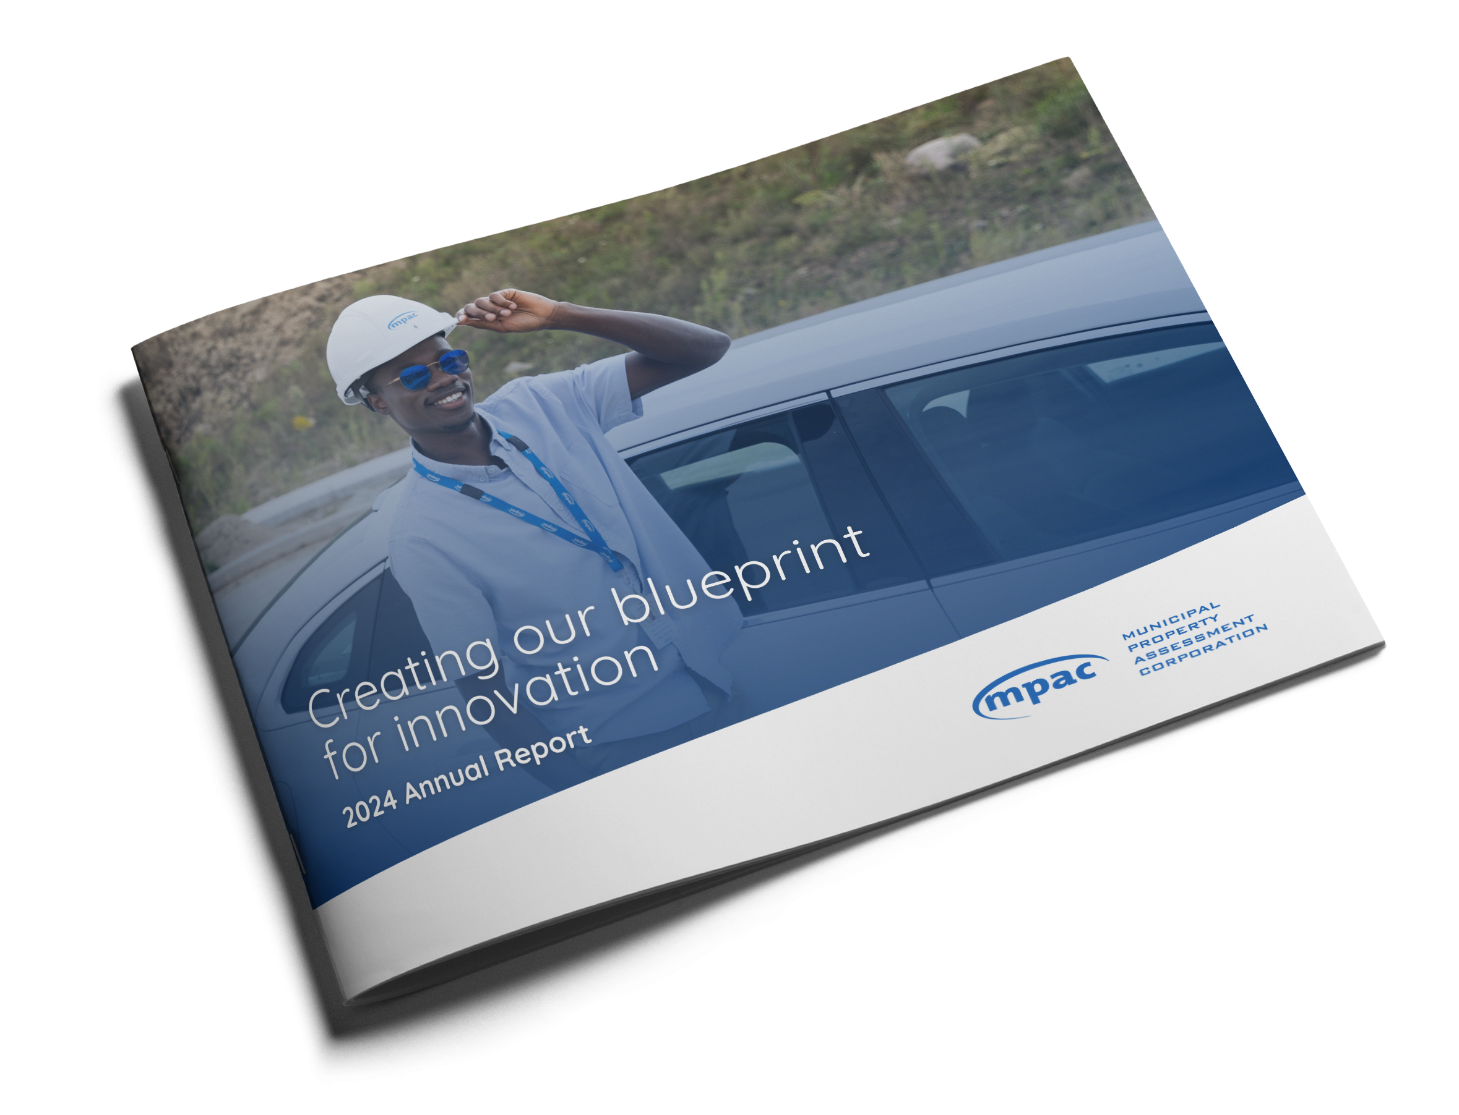
We're here to help
Check out resources at mpac.ca
Reach out to your local MSR team
Municipal Connect
Webinars + workshops
Conferences
Orientation sessions
Social media and engagement toolkits
Educational videos
Municipal resources + Property Assessment Toolkit
InTouch newsletter
2024 Municipal Partnerships Report
2024 Performance
Report
2024 Annual
Report

