Slide 1
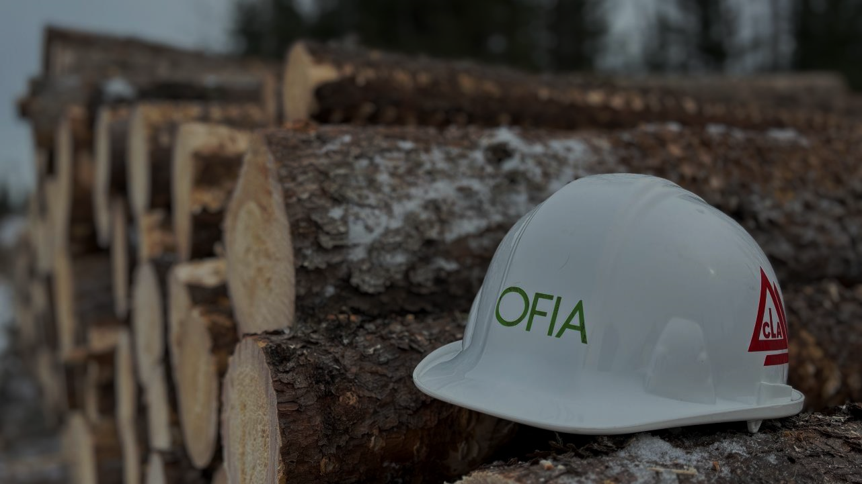
Stand & Grow
Seizing Opportunities in Ontario’s Forest Products Sector

Slide 2

Backbone of Ontario Communities
$5.5B/Yr in provincial GDP
137,000 direct, indirect, & induced jobs
70 Million Trees Planted/Yr
Indigenous Ownership & Leadership

Slide 3
Woodlands
Mills
Markets

Slide 4
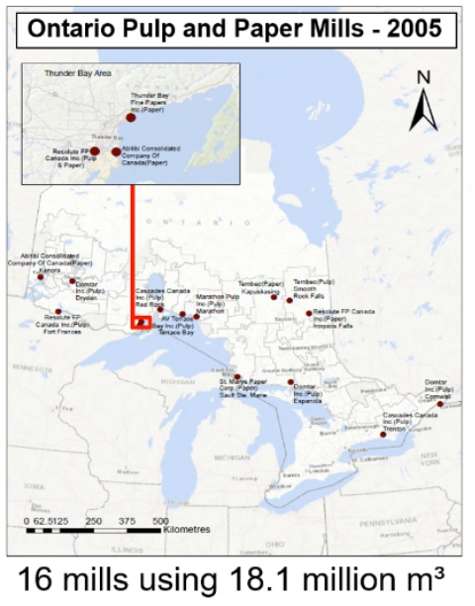
Annual Ontario Harvest (m³)

Slide 5
Market Pulp & Newsprint Production
(Tonnes/Yr)

Slide 6
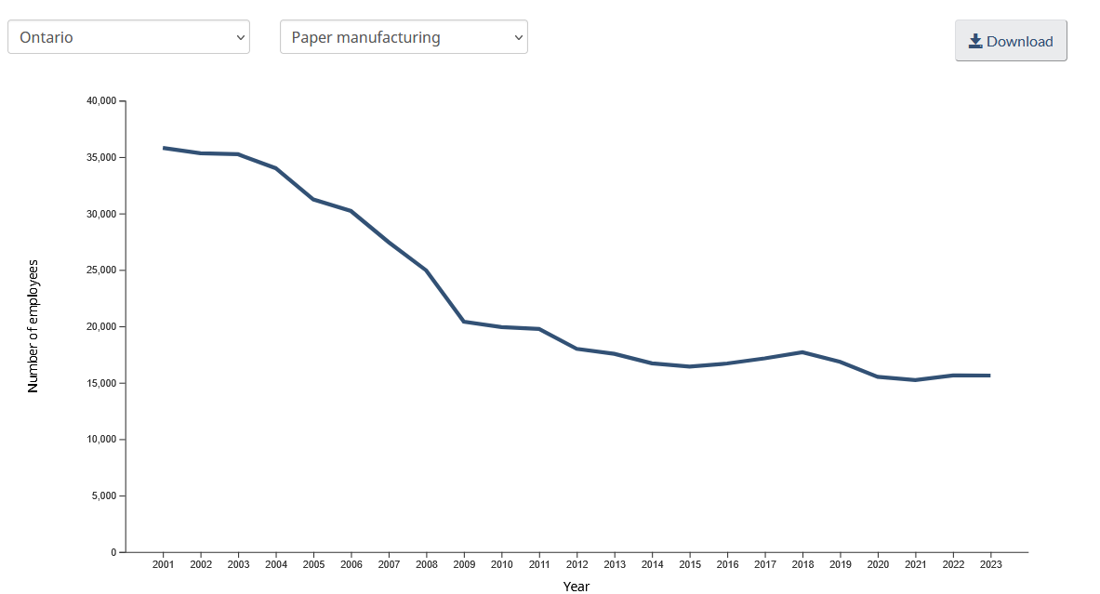

Slide 7
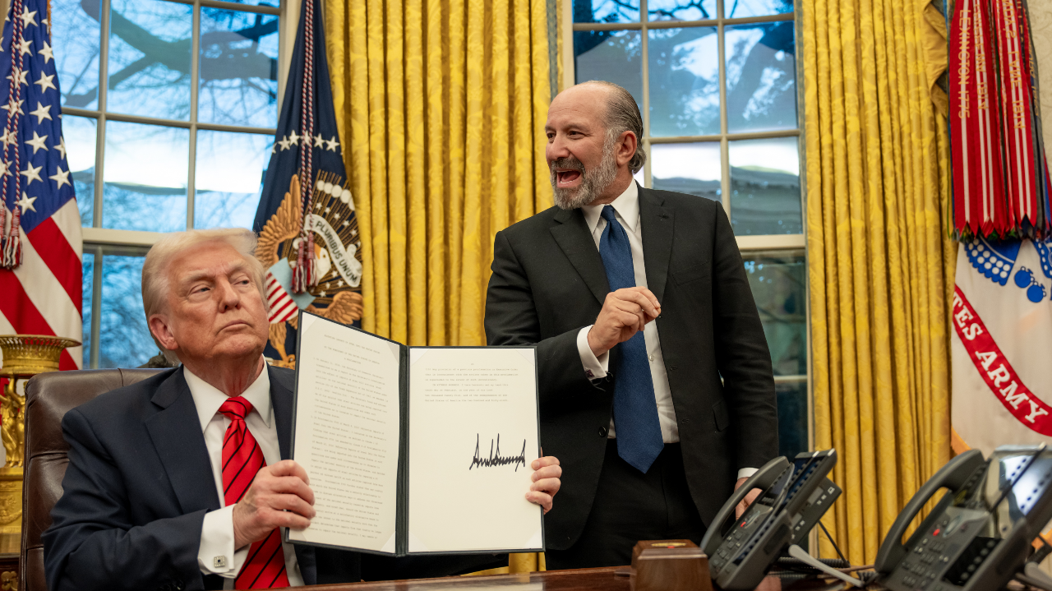

Slide 8
Trade Action & Executive Orders
Existing softwood lumber trade dispute
Lumber V began at the end of the last agreement in 2016
>$7B USD + interest on deposit
35% preliminary anti-dumping and countervailing duties effective July/August
Broad-based ~25% tariffs and Canadian countermeasures
EO sec. 232 National Security investigation into forest products
EO ordering the deregulation of logging on national lands & species at risk permitting

Slide 9
What Does This Mean?
Ongoing and immediate impact on American consumers
US domestic lumber consumption/production
Pulp, paper, and tissue products – importance of NBSK
Approximately 2.8 billion bd/ft of US capacity indefinitely or permanently shut down within the last 16 months – the US can’t flip a switch to increase lumber production
Immediate cash flow implications for Ontario producers
Longer-term impact of capital investment

Slide 10
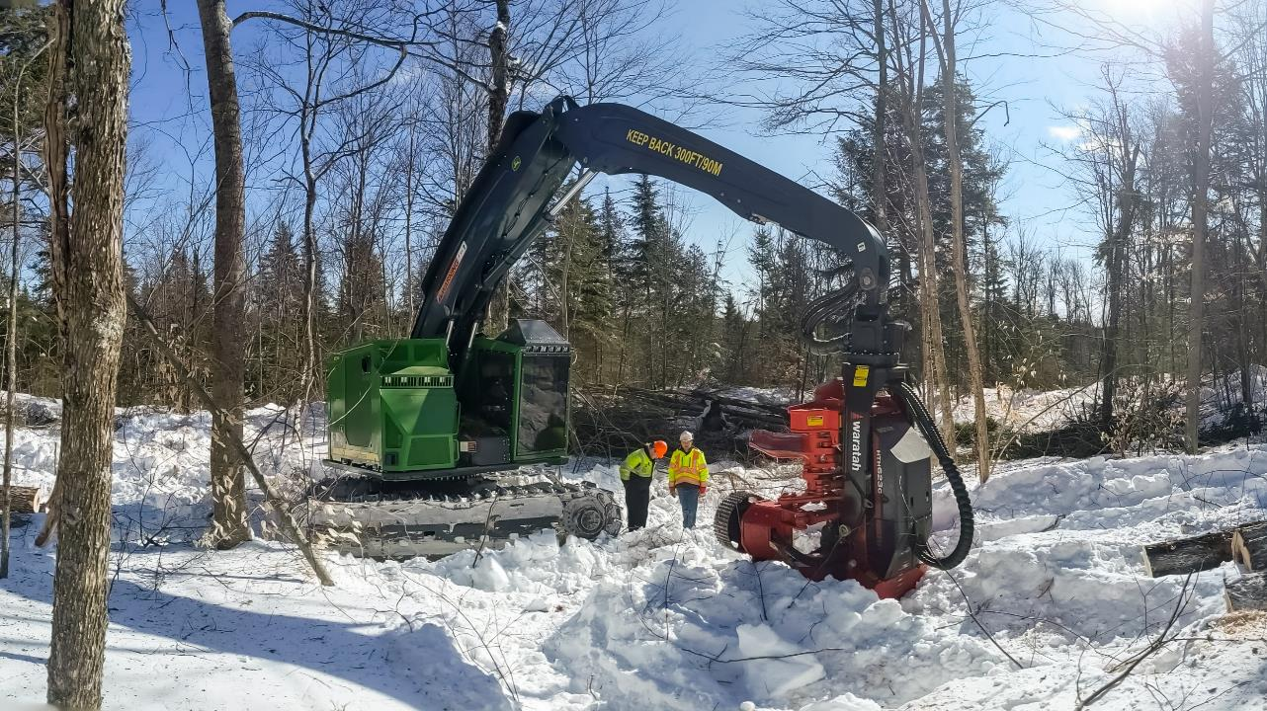
What can we do?

Slide 11
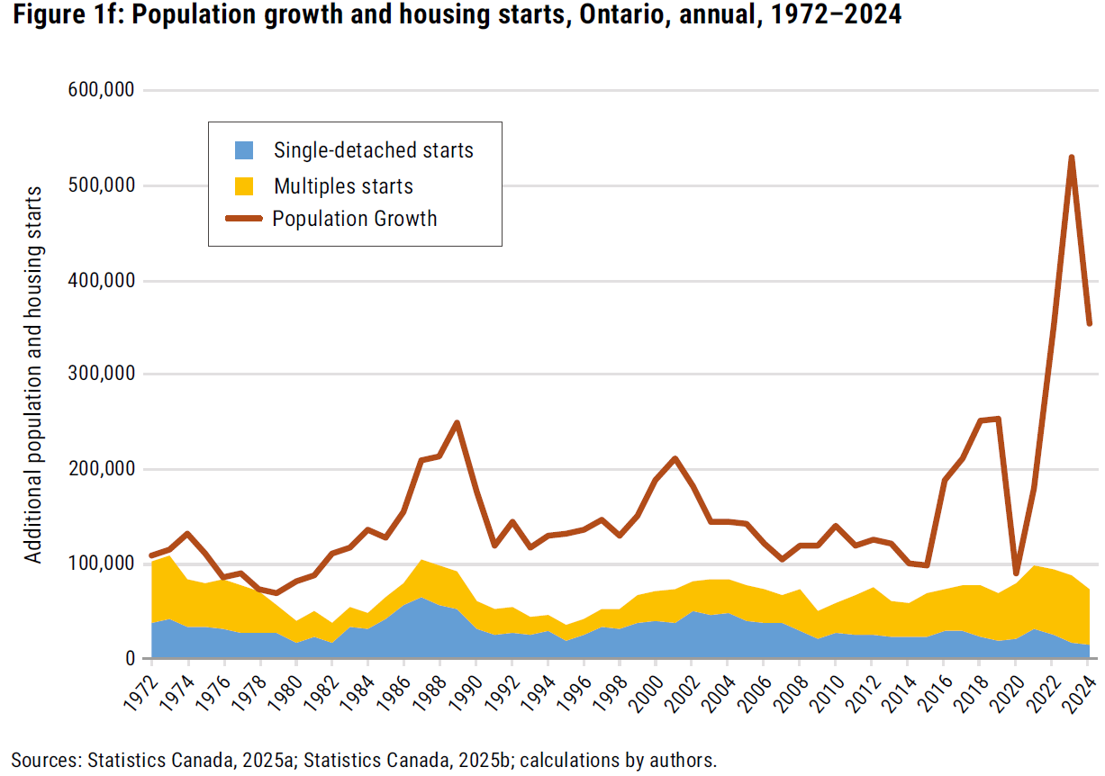

Slide 12
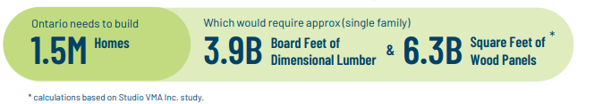
Source: Centre for Research & Innovation in the Bioeconomy (CRIBE)

Slide 13
New Energy Demands Present Bioenergy Opportunities
National/provincial energy security
>80% of bioenergy expenditure stays within the region, and over 95% of other fuels leave
Context for energy demand/supply has changed dramatically over the last 7 years – need 75% more power by 2050

Slide 14
Sources: For U.S. States, the U.S. Energy Information Administration, Electricity Data Browser: https://www.eia.gov/electricity/data/browser/. For countries, International Energy Agency, https://www.iea.org/countries. For Ontario, currently unpublished data from OEB for year-end 2023.

Slide 15
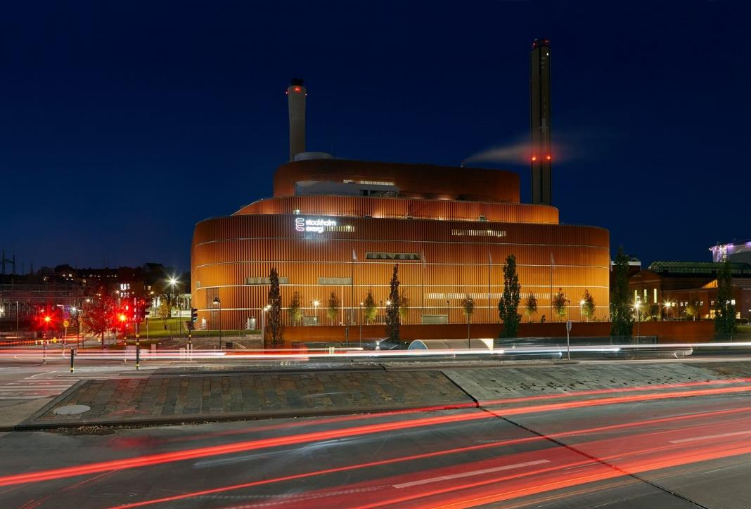
KVV8 Biomass CHP Plant Värtahamnen, Stockholm
Heats 190,000 homes with district energy
750 GWh of electricity
100% wood chips – 3,500 t/day
1,700 GWh heat
Reduction of 650,000 t CO²e/yr

Slide 16
Beyond Electricity
Decarbonizing Heavy Industry, Fuels, and Residential/Institutional Heating
Source: Powering Ontario’s Growth, https://www.ontario.ca/page/powering-ontarios-growth

Slide 17
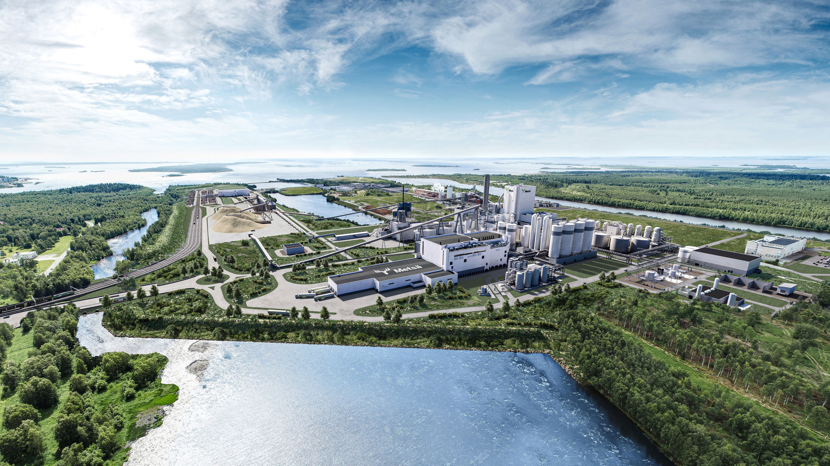
A path forward.
Spur domestic markets
Implement OFIA’s Forest Energy Directive - reserve a block of MWs dedicated to doubling the footprint of biomass electricity, 10-yr + PPAs, bioheat, DE, etc.
Made-in-Ontario supply chain for domestic housing
Invest in public transportation infrastructure, successful forest sector programs
More competitive environment for investment - make Ontario’s forest industry & bioeconomy a priority sector

Slide 18
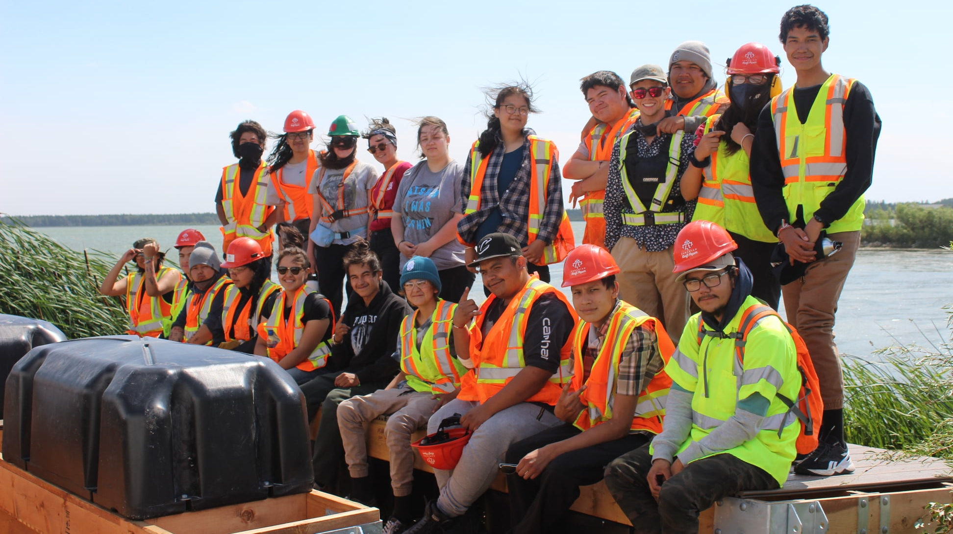
Thank you

