Slide 1
Unlocking the Power of Artificial Intelligence for Municipal Innovation
Olya Sanakoev for FONOM 2025
Scan for materials

Slide 2
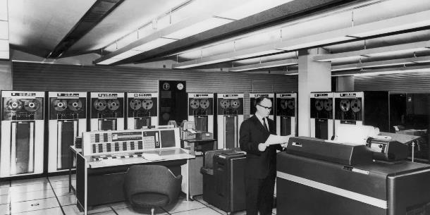

Slide 3
AI
Artificial Intelligence:
Making the machine act (provide an output) in an intelligent way
ML
Machine learning:
Method to learn from data (aka experience) in order to improve quality of output
Deep learning:
A specific way to make machines learn by allowing data to be less structured
DL

Slide 4
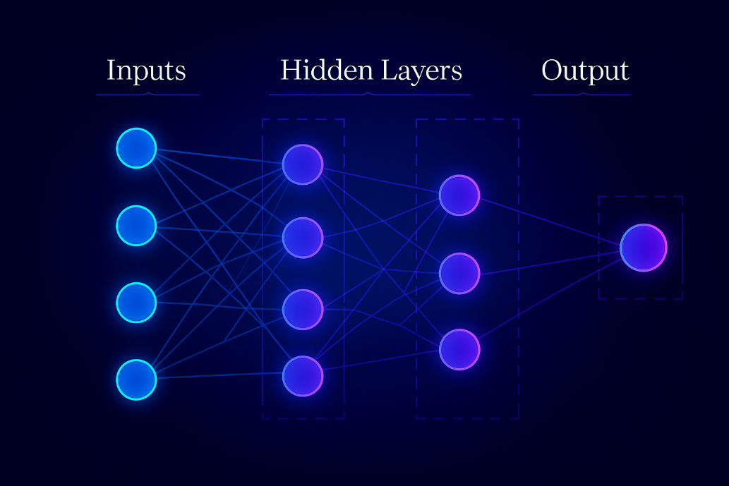

Slide 5
Same AI. Different Instructions. Different Results.

Slide 6
What makes a great prompt?
Be clear and simple
Give context
State your specific goal — are you asking it to explain, summarize, or analyze?
Add any limits or constraints
And, this is a big one: give it a role. Try saying: “Act as a data analyst” or “Act as an internal auditor” — and watch how the tone and structure shift.
Scan for materials

Slide 7
Using AI: Personal Playground

Slide 8
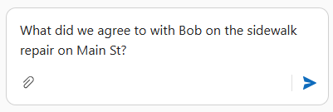
Using AI: Document Retrieval

Slide 9
Using AI: Data Analysis

Slide 10
Using AI: Smart Cities

Slide 11
Checklist: your foundations
Data
People
Systems & Infrastructure
Start with what you have.
Augment – not replace.
Use what’s already available.
Scan for materials

Slide 12
Legal Landscape
Unacceptable Risk Social scoring, manipulation
High Risk Transportation, safety, financial
Limited Risk Chatbots
Minimal Risk Spam filters, AI rendering in games
PIPEDA
Bill C27/AIDA

Slide 13
Roadmap: Crawl – Walk – Run
Infrastructure & decision making
Human in the loop
Test, learn, low risk
Scan for materials

Slide 15
Thank you!
Olya Sanakoev / olya@olya.org
Scan for materials

