Slide 1
Federation of Northern Ontario Municipalities ​
May 7, 2025
Dr. Owen Prowse
Vice President, Clinical Partnerships and Hospital Relations
Notes:
Good morning.
My name is Dr. Owen Prowse, and I am honoured to be here on behalf of NOSM University this morning.
I am the Vice-President of Clinical Partnerships and Hospital Relations with the university and ….
Thank you for having me here today along with my university colleague Jessica Pope.

Slide 2
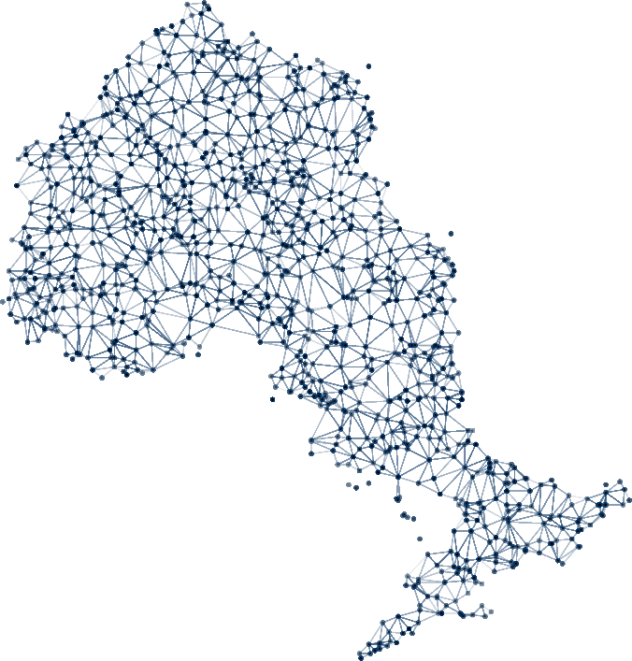
Territory Acknowledgement
We gratefully acknowledge the Elders and Knowledge Keepers who share their gifts and teachings with us so that we may better understand and honour their wisdom, and that of all Traditional Keepers of this land.
NOSM University will continue to practice reconciliation by listening, learning and fostering a culture of mutual respect and trust.
Notes:
Before I begin this morning…
I would like to say that as representatives of NOSM University, we are grateful to be here today in the traditional territory of the Anishinaabek Nation, protected by the Robinson Huron Treaty of 1850.
I would also like to specifically honour the people of Nipissing First Nation and Dokis (dough-KEESE) First Nation for whom this land is home.
It is an honour to be here.

Slide 3
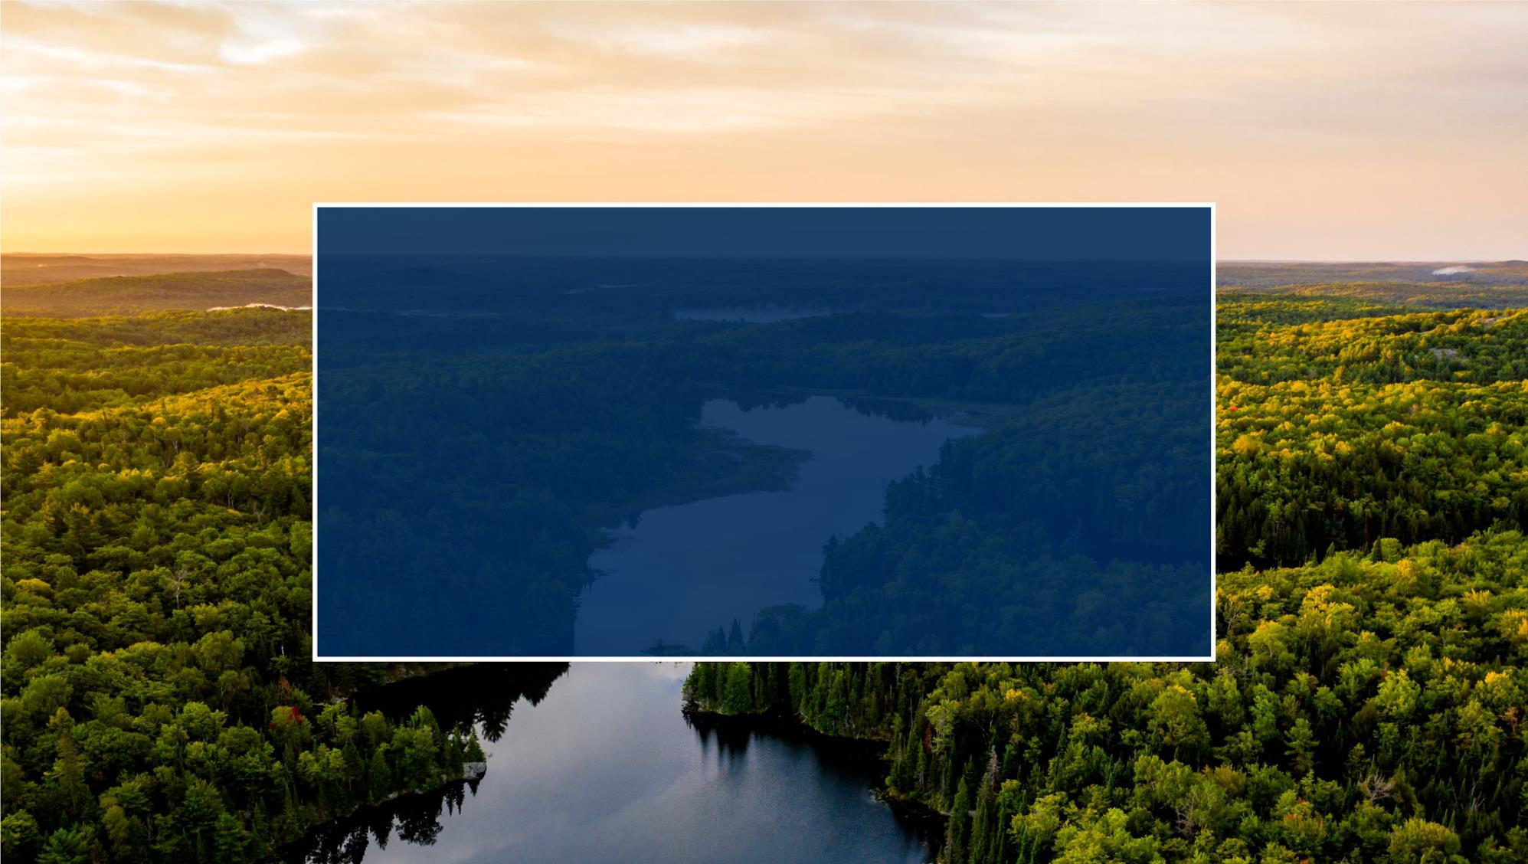
MISSION
To improve the health of
Northern Ontarians by being socially accountable in our education and research programs and advocating for health equity.
5
Notes:
NOSM University is Canada’s only independent medical university and one of the country’s greatest health human resource strategies.
Since our inception, our unique mission has remained the same: “To improve the health of Northern Ontarians by being socially accountable in our education and research programs and advocating for health equity.”
Some twenty years after we opened our doors, our core work remains educating a skilled, capable, and socially accountable health professions workforce to meet the unique health care needs of Northern Ontario—striving for health equity—and doing research that identifies and addresses community need.
Before we get into details about where we are and where we think we’re going, I just want to say…

Slide 4
Notes:
… an enormous ‘thank you’ to FONOM communities for your continued advocacy on behalf of NOSM University.
This is just a very small snapshot of some of the recent advocacy work done by your members over the last few years.
On top of your vocal support for our founding back in the early 2000s…
You have recently championed us in calls to the province for millions more in necessary base funding, more spaces to train new doctors, and much more.
We thank you so much for your support.
It has made a world of real, tangible difference to our university, including the historic expansion announcement to nearly double capacity in our medical programs.
Thank you!

Slide 5
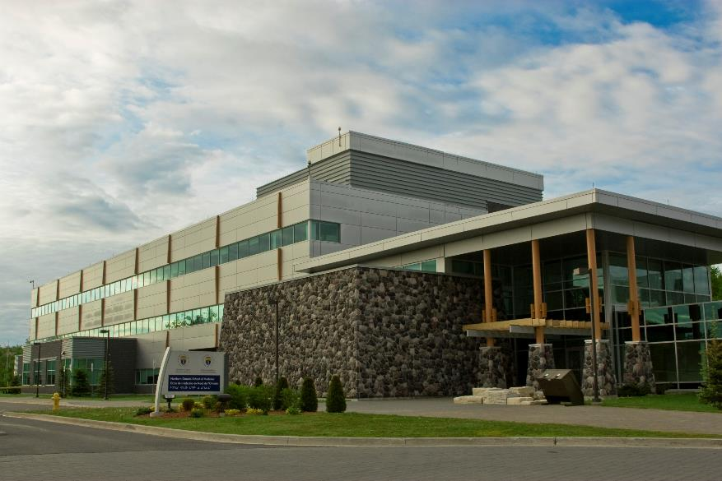
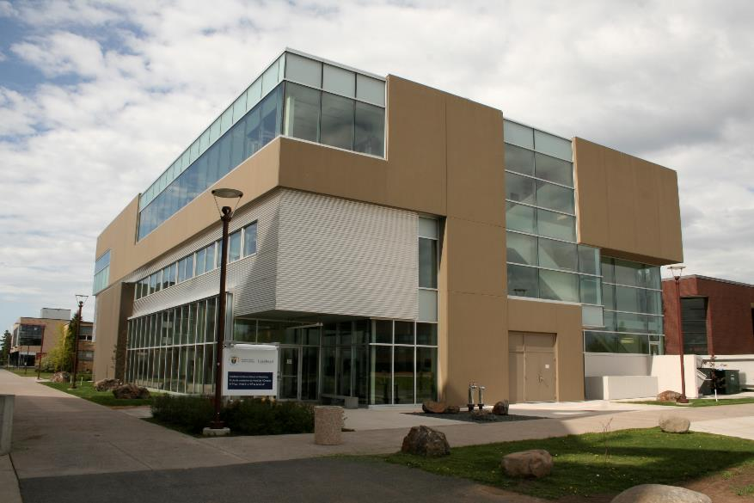
One of Canada’s Greatest Health Human Resource Success Stories
Sudbury Campus
Thunder Bay Campus
Notes:
As many of you know, we were established as the Northern Ontario School of medicine in 2002 to reverse the chronic shortage of physicians with a mandate to improve the health of Northern Ontarians with a focus on rural, remote, Indigenous and Francophone populations.
We officially opened our doors in 2005 with that social accountability mandate, and we have truly blazed trails in our short history.
A few things to know about NOSM University:
We have been an independent legal entity (not-for-profit corporation) since 2002
Though we maintain important partnerships with Lakehead and Laurentian universities, as of 2022, we are a fully independent, accredited, degree-granting university with our own Board of Governors and Senate, curriculum, and administration.
We were established by the government as a specific government health care strategy. As such, we are uniquely supported by provincial funding through both the Ministry of Colleges, Universities, Research Excellence and Security, and the Ministry of Health
In addition to hundreds of staff split 50/50 in Sudbury and Thunder Bay, NOSM University manages close to 1,800 clinical faculty contracts across the North, which is what we consider the entirety of the actual NOSM University campus.

Slide 6
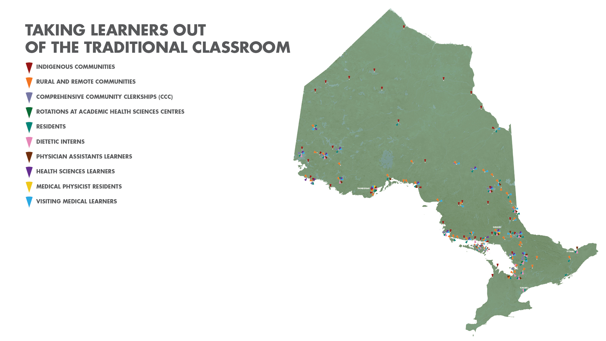
Notes:
The unique distributed, community-engaged learning model has grown into something extraordinary and is recognized on an international level.
This model includes strong ties and engagement with remote, rural, Indigenous and Francophone communities.
It features partnerships and collaborations with more than 500 organizations, in 90-plus communities, and again—with more than 1,800 clinical, human and medical sciences faculty dispersed across all of Northern Ontario.
This map is telling of where the concentrations of medical schools are in Ontario.
The pink symbols are med schools based in southern Ontario.
The two blue symbols are NOSM University’s campuses in Thunder Bay to the west, and Sudbury in the east.
All of the little chevrons across the North represent NOSM University’s presence across the region.

Slide 7
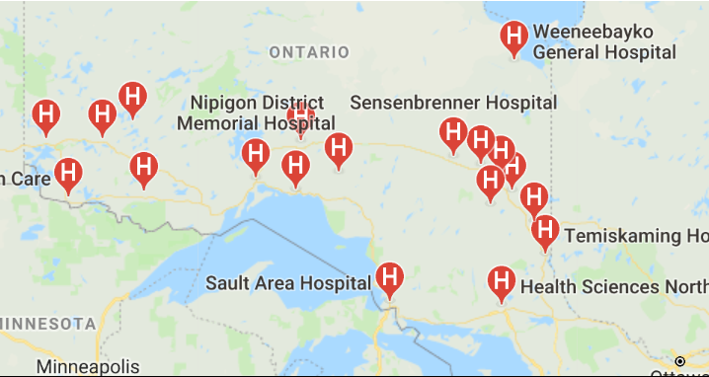
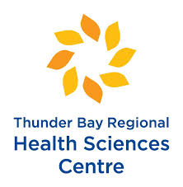
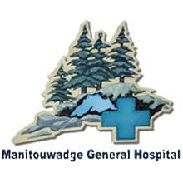
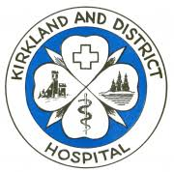
Connections
Two Academic Health Science Centres
Over 40 Hospitals in North-East and North-West
8 Colleges and Universities
Over 60 Health Care Organizations in Northern Ontario
Notes:
As you can see, we are deeply connected to health care partners across the North.

Slide 8
Astorville
Atikokan
Bearskin Lake
Big Trout Lake
Blind River
Bracebridge
Bruce Mines
Burk's Falls
Callander
Chapleau
Chelmsford
Cochrane
Constance Lake
Couchiching
Cutler
Dryden
Eabametoong
Elliot Lake
Emo
Espanola
Fort Frances
Fort Hope
Geraldton
Gore Bay
Gravenhurst
Hearst
Huntsville
Ignace
Iroquois Falls
Kapuskasing
Keewatin
Kenora
Kingfisher Lake
Kirkland Lake
Little Current
Lively
Manitoulin Island
Manitouwadge
Manitowaning
Marathon
Matheson
Mattawa
M'Chigeeng
Mindemoya
Moose Factory
New Liskeard
Nipigon
Noelville
North Bay
North Spirit Lake
Parry Sound
Pikangikum
Powassan
Rainy River
Red Lake
Richards Landing
Sandy Lake
Sault Ste. Marie
Schreiber
Sioux Lookout
Smooth Rock Falls
South River
Sturgeon Falls
Sudbury
Sundridge
Temiskaming Shores
Terrace Bay
Thessalon
Thunder Bay
Timmins
Val Caron
Verner
Wawa
Webequie
Wunnumin
NOSM University Learners: 3747
Rotations: 18,733
Notes:
Having so many connections through our distributed model means we can put students across the region for opportunities to train and learn in the North.
This is a snapshot of where learners have been placed in Northeastern Ontario.

Slide 9
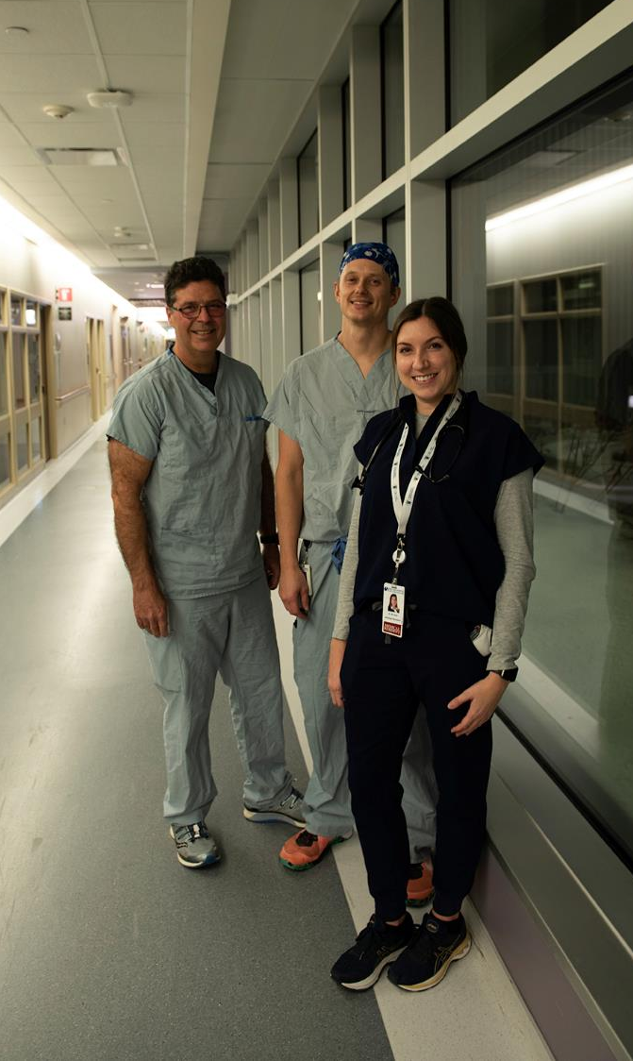
NOSM University Impact
Sault Ste. Marie
As of June 2024, NOSM University has graduated 971 MDs—80 are Indigenous and 198 are Francophone. More than half of these physicians have stayed in Northern Ontario.
On average, 52.67% of NOSM MD grads select Family Medicine as their first choice for residency, compared with 38.20% for all Canadian applicants.
889 residents have completed training
31 Indigenous and 59 Francophone.
207 Registered Dietitians have completed their program.
75% of our last three graduate cohorts are practising in Northern Ontario.
Notes:
More than half of NOSM University graduates have stayed in Northern Ontario. We estimate that about 400,000 people in Northern Ontario—about half the population—have been helped by one of these graduates.
Despite this success, there continues to be a crisis in the numbers of doctors and other health-care practitioners in Northern Ontario’s smaller rural, remote, Indigenous and Francophone communities.
The people of Northern Ontario—some 800,000—need more than 380 doctors just to fill immediate shortages. It’s hard to imagine, but statistically, people in the North live shorter, less healthy lives than people in the south.
As Canada’s first-ever independent medical university, NOSM University is doing everything it can to help marshal doctors to where they’re needed most.

Slide 10
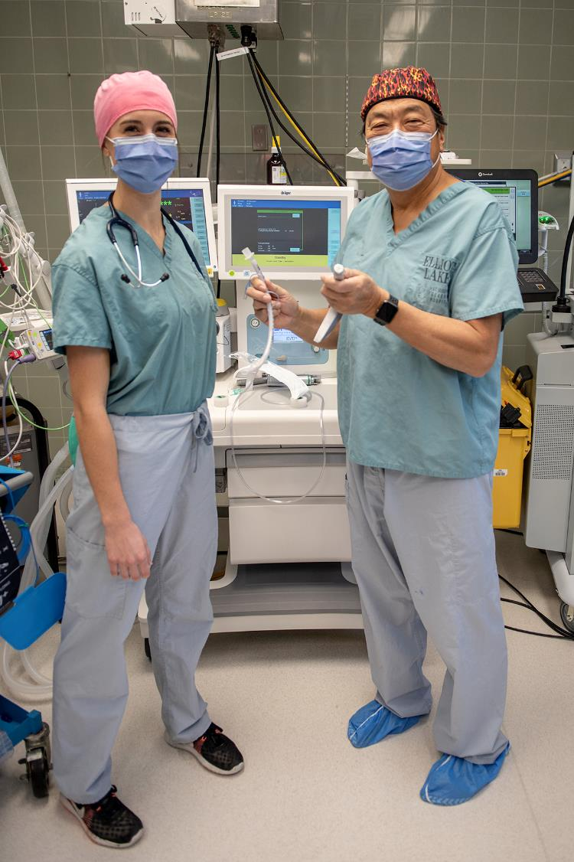
Elliot Lake
Expansion Ready and Student Success
Training in the North, by the North, for the North works.
Recently announced expansion will take place steadily over 5 years:
UME: increase 64 to 108 by 2028.
PGME: increase from 60 to 123 by 2028.
Notes:
The excellent news is that we are growing.
In 2022, we announced an extraordinary expansion effort.
The province at the time was assigning new medical school spaces, and NOSM University received a lot.
Our initial MD class back in 2005 was 56 students per year.
Through a gradual, incremental approach, we plan to offer a total of 108 seats, nearly doubling the capacity of our MD program; at the same time, we expect to go from 60 postgraduate positions to 123 by 2028.
Although the exact numbers of postgraduate program expansion are not yet decided, the likely doubling of our postgraduate positions could drive the opening of new specialty training programs.

Slide 11
What is the Need?
Currently across Northern Ontario we need at a minimum:
380 full time equivalent physicians.
Of this group we need 180 specialists and over 200 family physicians - 110 of these in rural communities.
We need Royal College specialists in a variety of disciplines with the highest numbers in:
Psychiatry
General Internal medicine
Pediatrics
Emergency medicine (CCFP EM or FRCPC)
Anaesthesia
Obs/Gyn
We also need small numbers in plastic surgery, respirology and neurology - even though the numbers are small, some of these are critically important to service delivery and so are in “high need.”
As of June 2023

Slide 12
National Perspective
Canada's physician-to-population ratio (age-adjusted) ranked 26th among 28 developed nations that maintain universal access health care.
Canada's physicians are unable to meet the demand for health-care services because there are simply too few of them.
While the number of physicians being trained in Canada has increased, Canada is still not training enough new doctors to maintain the physician-to-population ratio at its current level, let alone increase it.

Slide 13
So What? What does this mean for you?
Economic Impact
access to quality health care attracts business and enables community growth
Healthy cities make wealthy cities
Integrated approach to HHR – the key to recruitment and retention
Build a collaborative environment to co-develop, validate and adopt health-care solutions

Slide 14
Role of the Community
Economic growth, jobs and health of population
Making it attractive to work and live here
Competing with everyone else
Housing, schools, jobs for spouses, offices and lifestyle
Successful recruitment requires:
A well-organized and effective recruitment team,
Competitive offers e.g. turnkey operations,
Strategic planning for success in practice development, and
Sensitivity to the needs of the new hire
Doctors bring in jobs, taxes, other health-care professionals and economic drivers but primary care doctors are under immense pressure.

Slide 15
Mission, Planning, Organization, and Integrity
Five strategic directions:
Transform Health Human Resource Planning
Advance Social Accountability
Innovate Health Professions Education
Strengthen Research Capacity in Northern Ontario
Becoming a University
Four strategic enablers:
Valuing Our People
Managing Our Resources
Investing in Our Infrastructure
Sustaining Our Resilience

